Slide 1
Product Solution Design
Using concurrent framework

Slide 2
Activities
Business idea
Collect Functionalities
Block diagram representation of functional components
Map functionalities to components
Modeling & Storage
Communication & Networking
Security
Concurrent Architecture
Fit component to concurrent architecture
Later add additional components

Slide 3
Business Ideas
Before implementing real-time business ideas, build a sample or simple framework.
Create a baseline idea; you really don’t need to resolve any business problems.
Later, this baseline will help build additional advanced functionalities.
(e.g.): Build a concurrent architecture framework; later, add additional functionalities.

Slide 4
Collect functionalities
Each component should run independently.
One centralized component should control all the components.
Each component should have a communication channel to communicate with each other.
Each component should be scalable.

Slide 5
Collect functionalities ..
Each component should give a signal for life extension to the central component; otherwise, it should be stopped and restarted.
Should have a logging mechanism
Should have a supervisor model to start or stop in case anything goes wrong.

Slide 6
Functionality Groups
Functionalities discussed about
Components
Centralized control component
Communication channel
Super control
Logging

Slide 7
Block Diagram of functional components
Communication channel
Life line
Logical line
Logging line
Component 1
Component 2
Green line: communication with channels
Yellow line: control special power lines (stop or start).
Communication channel
Component 3
Control Component
Control

Slide 8
Concurrent Framework Architecture
Control
Component 1
Component 2
Component 3
Component 4
Communication channels

Slide 9
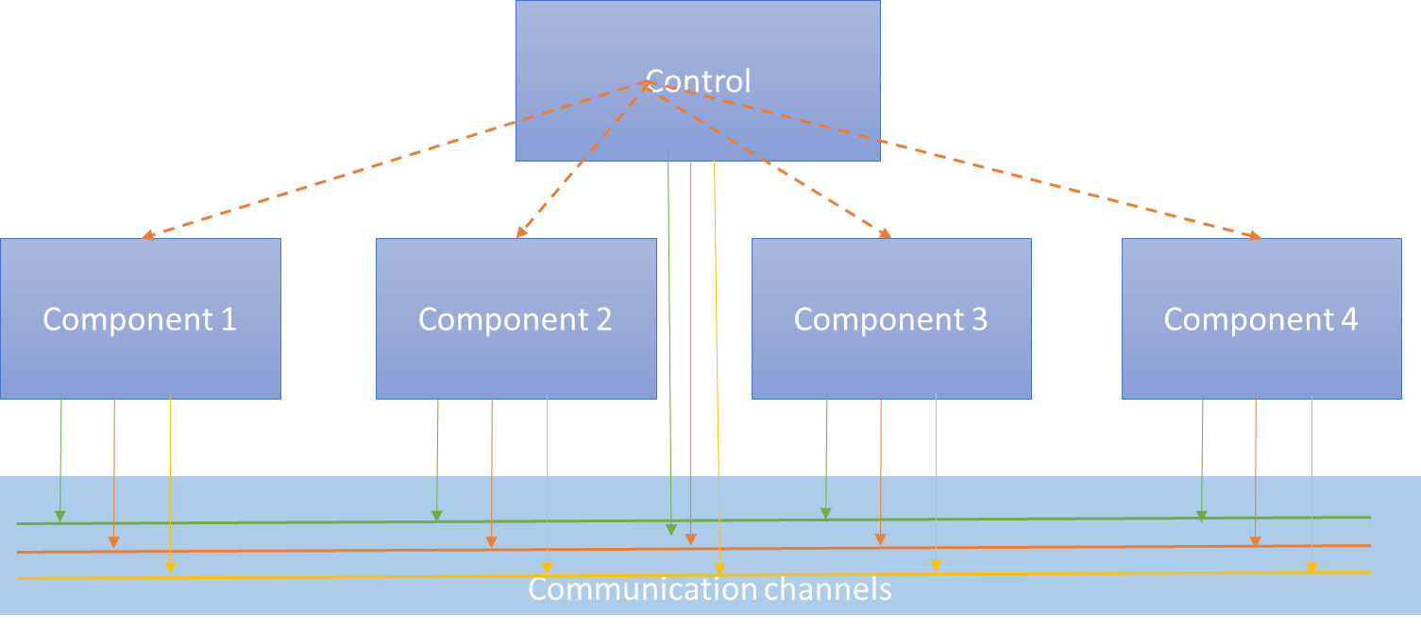
Concurrent Framework Architecture
Each Component should be a separate process with in a system or distributed system
Each component should have two or more threads
Each component should communicate through channel

Slide 10
Communication channel
Each component should independently talk to channels ( Three separate line for different functionalities)
Channels nothing but software / hardware interface.
Channel may be a : Stream , message Q , In Memory DB , RDBMS or Hardware
Line will be any programed interface
It should be in common place

Slide 11
Components
Separate functional units
Separate process running with it’s own memory / computations
It should have at least two threads or more..
Thread One – Life line signal to control
Thread two – Logic implementation
More.. – more separate logical unit implementation
Can be implemented in any language that support multi processing and multithreading

Slide 12
Control Components
Can start / Stop components
Monitor the components lives.
Extending the life of component or will restart the life.
It is also separate process.
It has two thread : one for life line check another one for components process controls
Can be implemented in any language that support multi processing and multithreading

Slide 13
Software selections
Just selected , which is simple and available
Python – for control the process and threads.
PostgreSQL - for storage and common sharing
Logic component may be in any tools or framework or language. Need to use remote / process calling method to co-ordinate

Slide 14
Conclusion
Will post the draft code … it is functioning good. But make sure security , restart ability , etc.. Before use in any critical area.

Slide 15
Modeling & Storage
Have following tokens & tracking's designed
Service Tokens - Each service should have ready token to getting started by controller.
Service Restart Tokens – life line extender will set / Manually can set this token to restart the service by controller
Process Tracking – Each process and services will be registered by controller for tracking purpose
Services life line signal tokens - Each service / process should send this signal tokens to life line extender to keep it’s life. Otherwise , will be killed by controller and restarted

